Slide 1

Science in our life
Grade 6
Unit: 8
Lesson:2
SB
Grammar

Slide 2
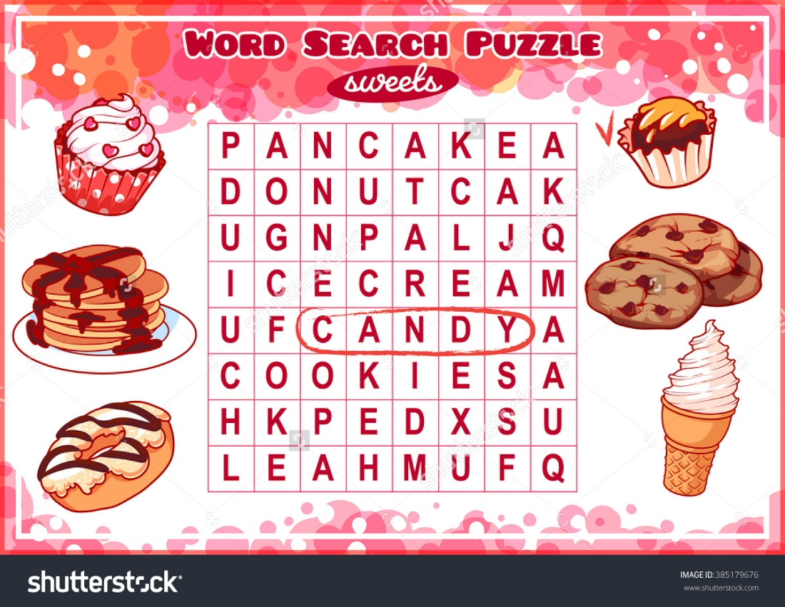

Slide 3
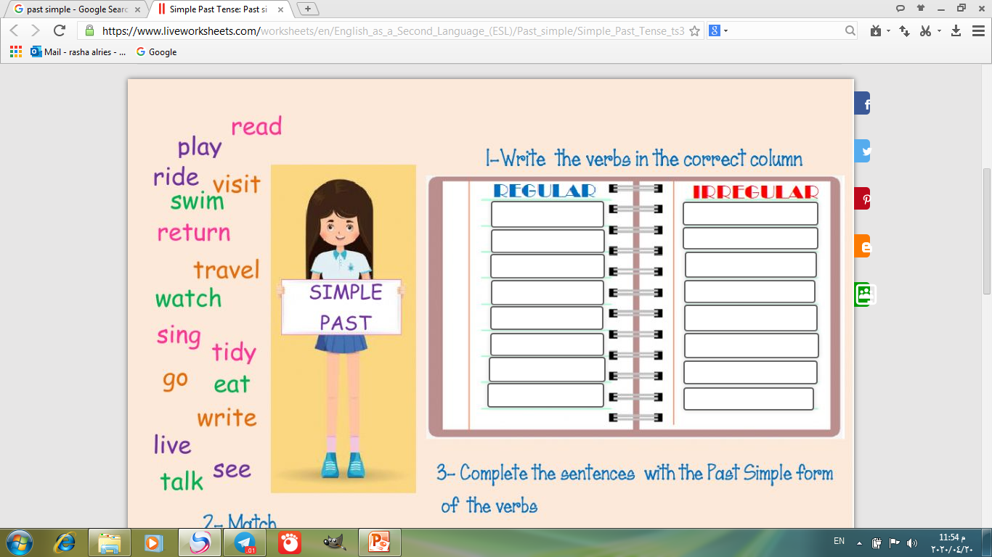
Revising some regular and irregular verbs using the past simple
played
swam
visited
ate
tidied
wrote
talked
sang
lived
saw
returned
went
watched
read
travelled
rode

Slide 4
Grammar Worksheet
EX. Choose the correct answer:
I spent a nice time last Summer holiday. I (travel - travelled – am travelling) to London with my family. We (go – went– goes) there by plane. We (stayed – stay – staying) in an expensive hotel. We (visits – visited – visit) many interesting places there.

Slide 5
Grammar Worksheet
EX. Choose the correct answer:
I spent a nice time last Summer holiday. I (travel - travelled – am travelling) to London with my family. We (go – went– goes) there by plane. We (stayed – stay – staying) in an expensive hotel. We (visits – visited – visit) many interesting places there.

Slide 6
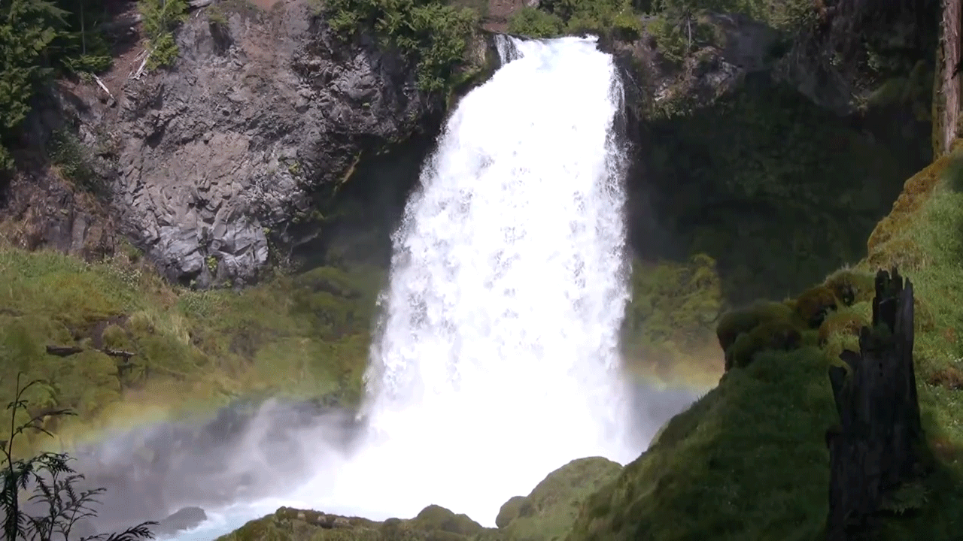
Let’s work out some puzzles to revise some active words.

Slide 7

To discover the exact size or amount of some thing
measure

Slide 8

export
Nurses use thermometer to ............temperature .
reflect
measure
invent

Slide 9
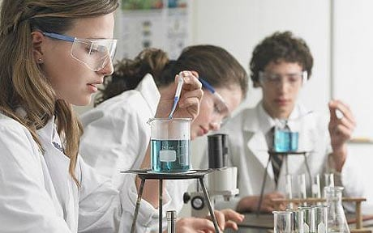
A scientific study to see what happens to a thing when some thing is done to it.
experiment

Slide 10
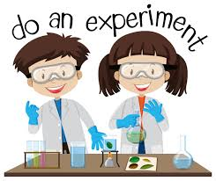
How should you behave in the science lab?

Slide 11
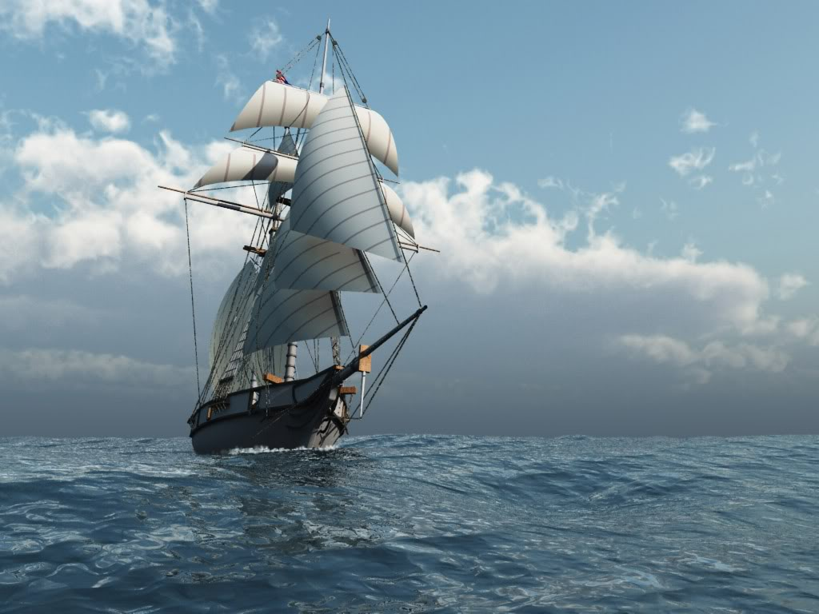
Student’s Book
page 66

Slide 12





will
won’t
might
could

Slide 13

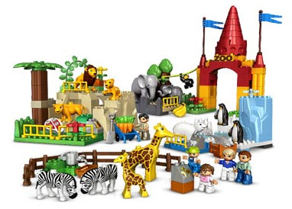

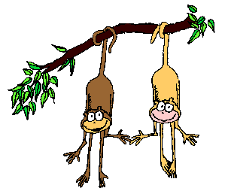

You are going to the zoo.
What will you see there?

Slide 14
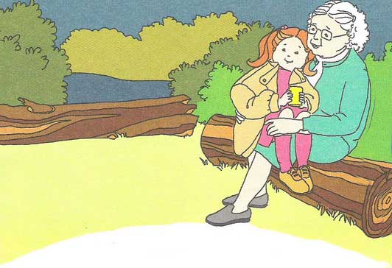
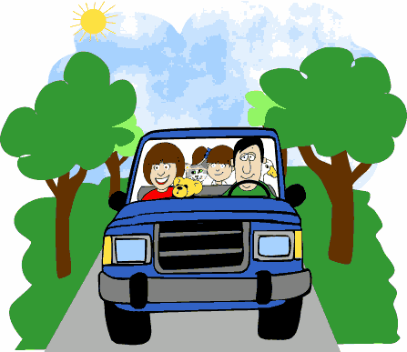
You are visiting your grandmother at the weekend. What might you do there?

Slide 15

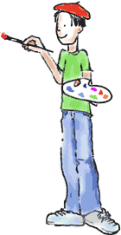
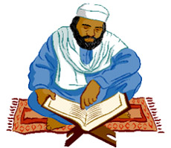
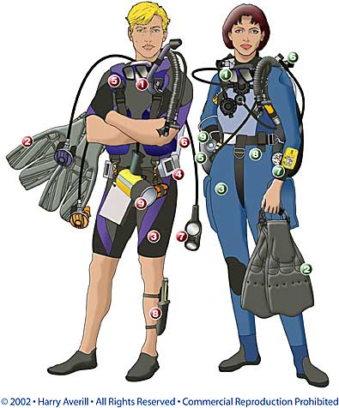
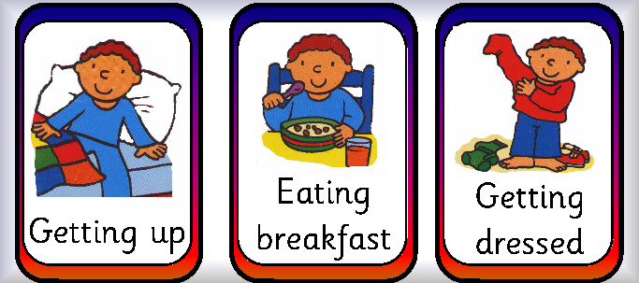
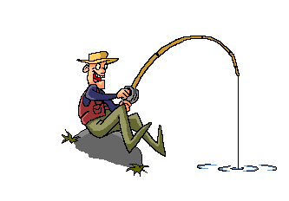
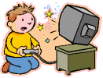

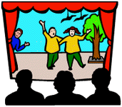
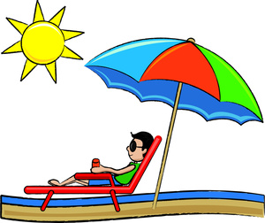
Give sentences to say what will, might or could you do tomorrow

Slide 16
will
I will go home after school.
I won’t eat in the class.
won’t

Slide 17
I might see my cousin soon.
It could rain later.
coulld
could

Slide 20

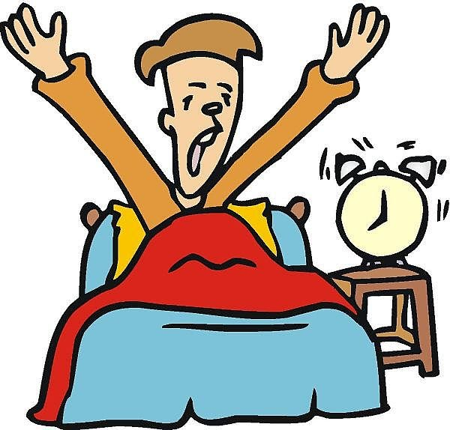
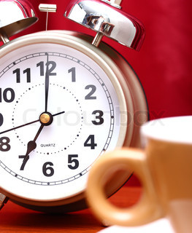
I will get up at 7 o’clock.
a
get up / 7 o’clock

Slide 21
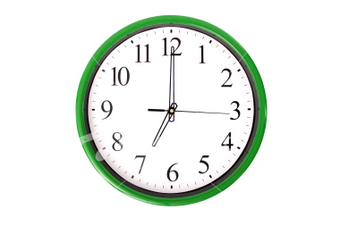
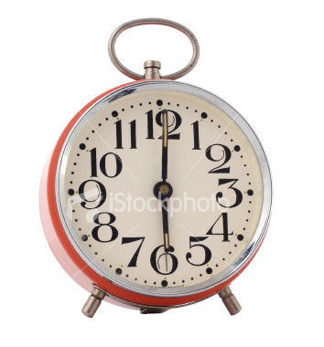
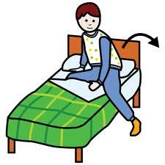
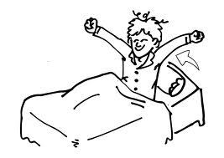
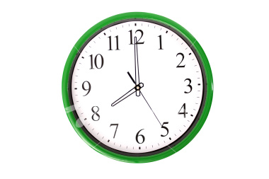
I might get up at 7 o’clock.
a
I won’t get up at 7 o’clock.

Slide 22
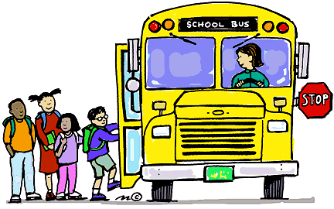
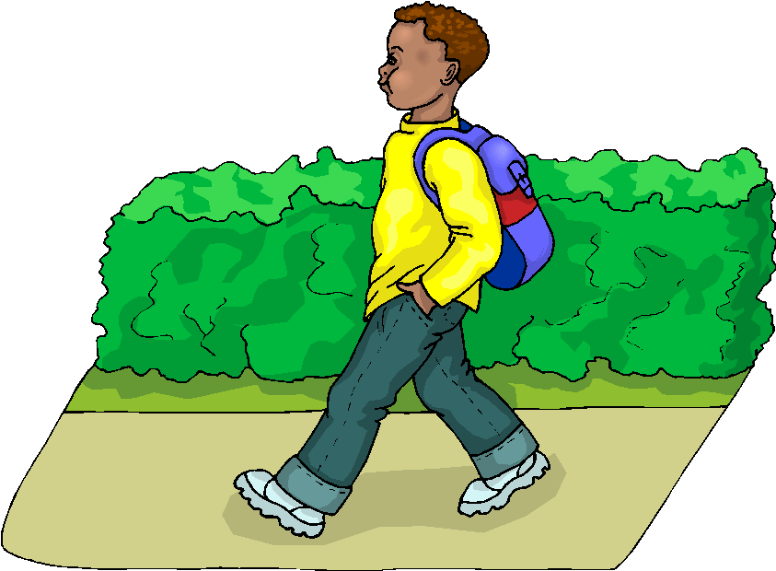
I will go to school tomorrow.
b
go/ school

Slide 23
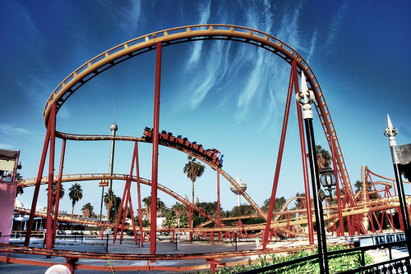
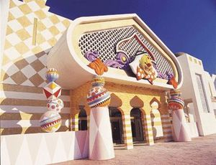
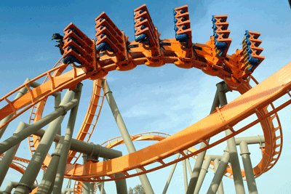
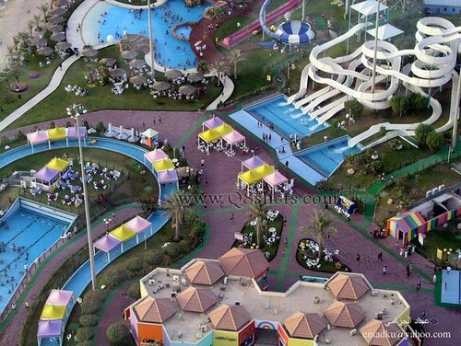
I won’t go to school tomorrow.
b

Slide 24
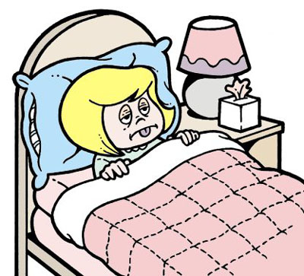
b
I might go to school tomorrow.

Slide 25
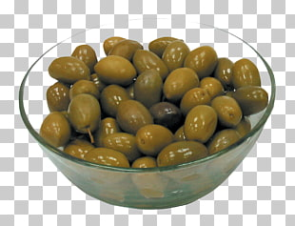
c
I will eat olives for breakfast.
eat olives/ breakfast

Slide 26
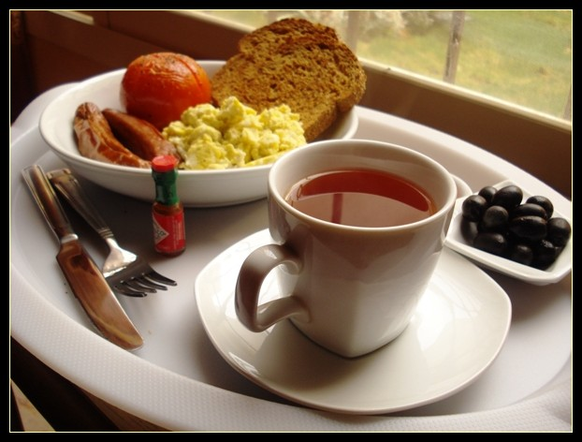
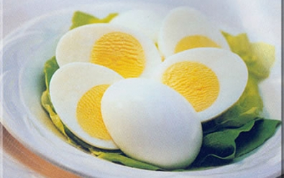
c
I might eat olives for breakfast.

Slide 27
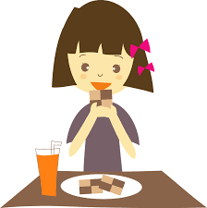
c
I won’t eat olives for breakfast.

Slide 29
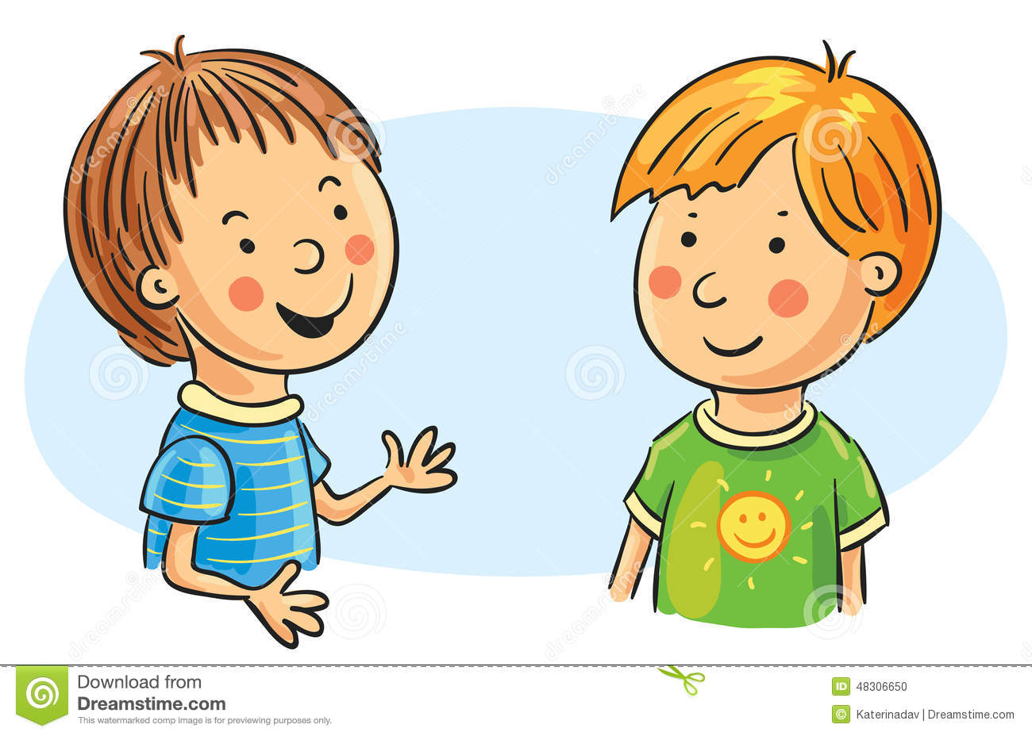
d
talk/ friend

Slide 30
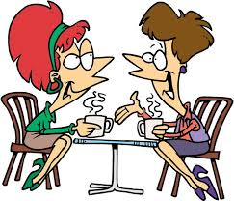
d
I will talk to my friend.

Slide 31
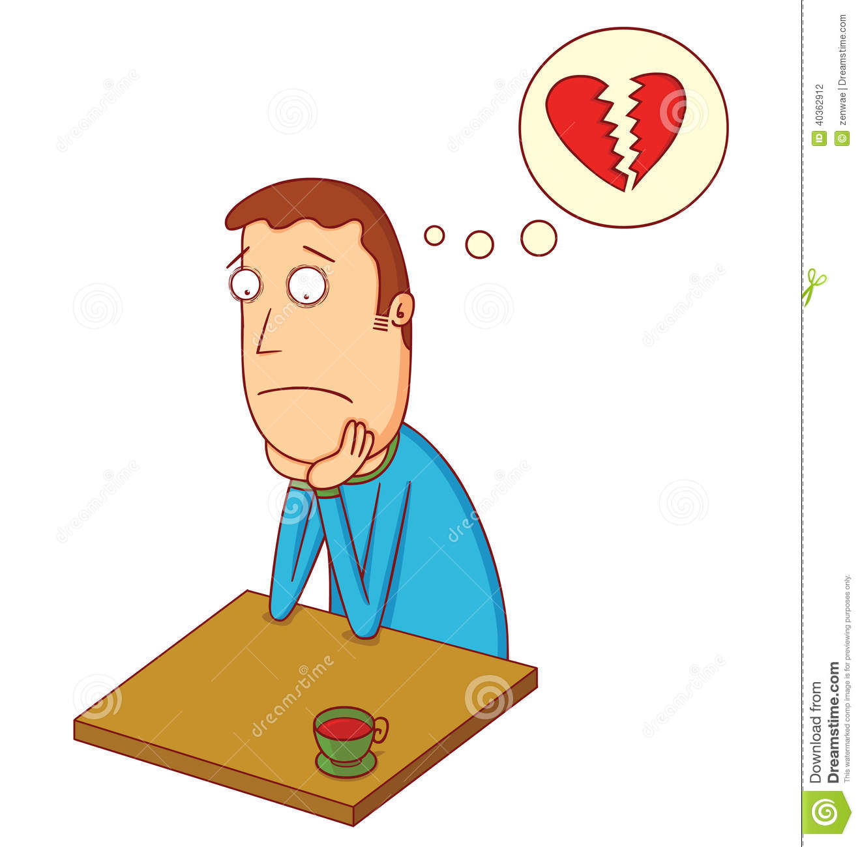
d
I might talk with my friend.

Slide 32
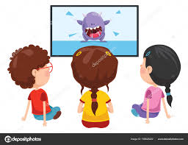
d
I won’t talk to my friend.

Slide 33
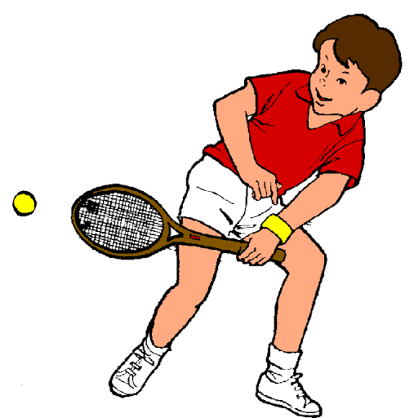
I will play tennis tomorrow.
I might play tennis tomorrow.
e
play/ tennis

Slide 34
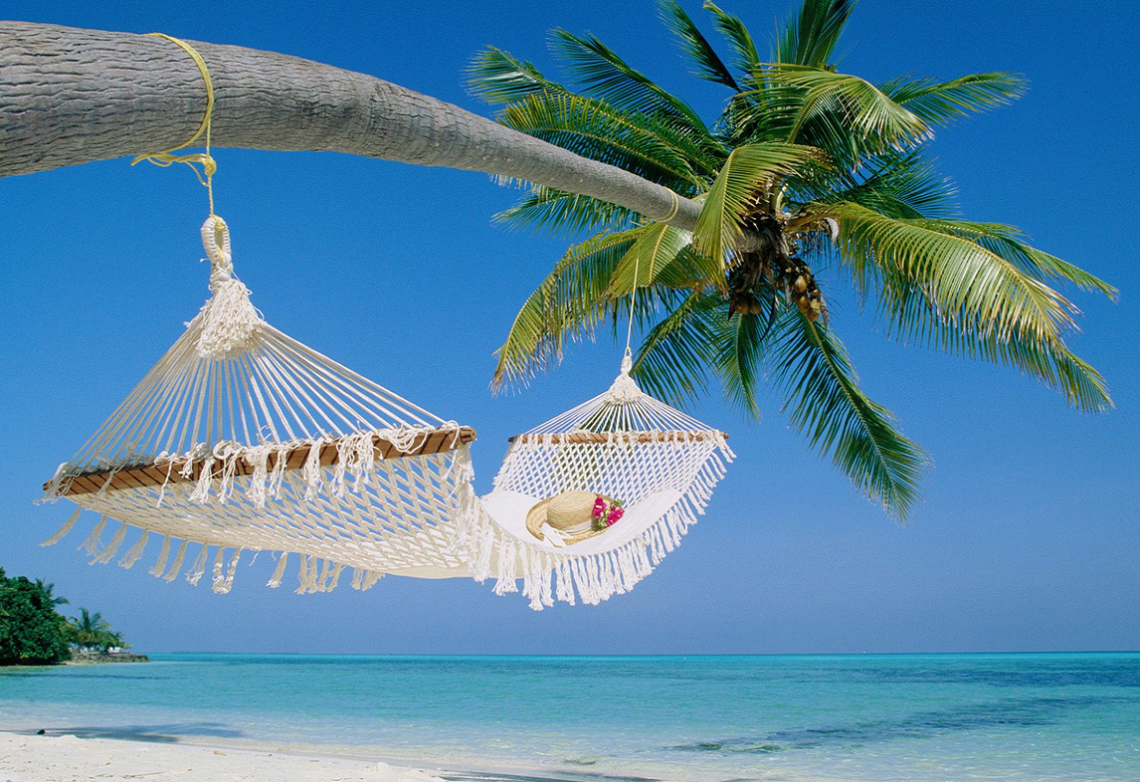
e
I won’t play tennis tomorrow.

Slide 35


I will get a surprise tomorrow.
f
get/ surprise

Slide 36


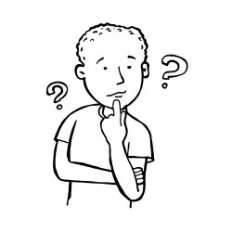
f
I might get a surprise tomorrow.

Slide 37
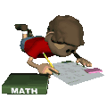
f
I won’t get a surprise tomorrow.

Slide 38
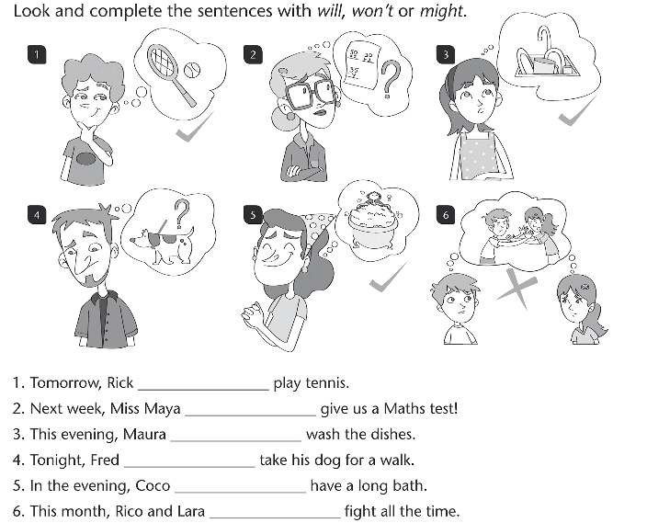

Slide 39
Exercise
Grammar
Choose the correct answer
Tomorrow, we ( will – could – might) travel to Bahrain with my father on business. We ( couldn't – won't – might ) go by car because my father can't drive for long distances. My mother ( might – will - could ) visit her old friend whom she missed so much. My father ( could – might – will ) take us in a tour in the place as he is really busy.

Slide 40
Exercise
Grammar
Choose the correct answer
Tomorrow, we ( will – could – might) travel to Bahrain with my father on business. We ( couldn't – won't – might not ) go by car because my father can't drive for long distances. My mother ( might – will - could ) visit her old friend whom she missed so much. My father ( could – might – will ) take us in a tour in the place as he is really busy.

Slide 41
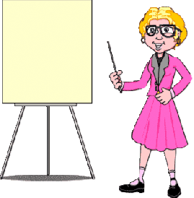
Student’s book
page 67

Slide 43



Slide 45
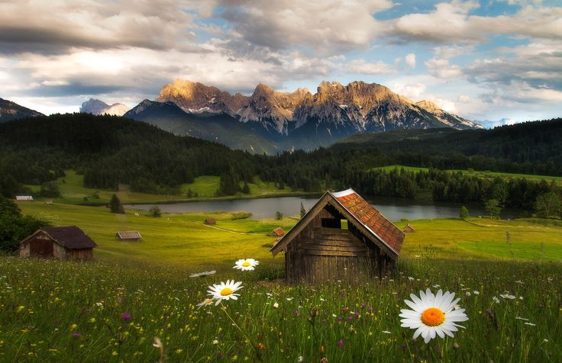
Closure

Slide 46
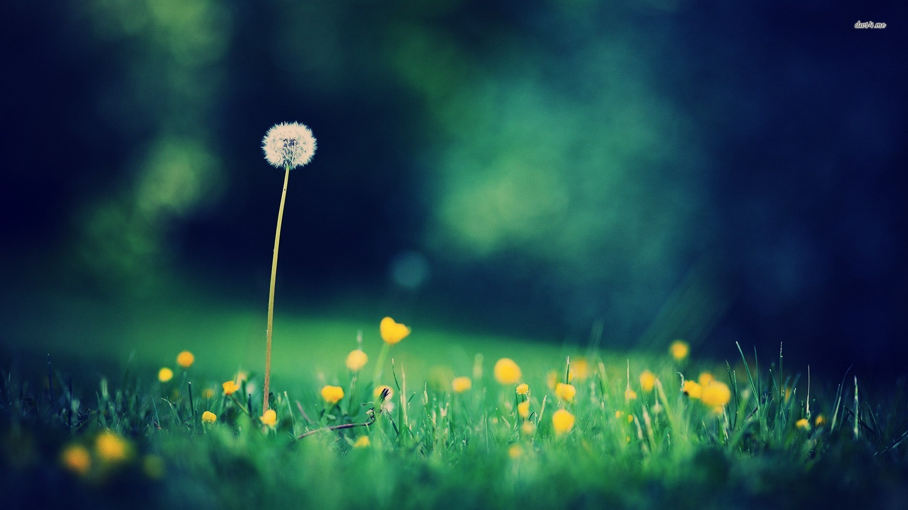
What will you do this evening?
What won’t you do this evening?

Slide 47


